Slide 1
Data commentary
Write the data commentary to accompany Figure 2, explaining and describing the trends in the graph. (200-250 words) Your text will be marked on content, discourse organisation, range and appropriacy of vocabulary and structures, and grammatical accuracy.

Slide 2
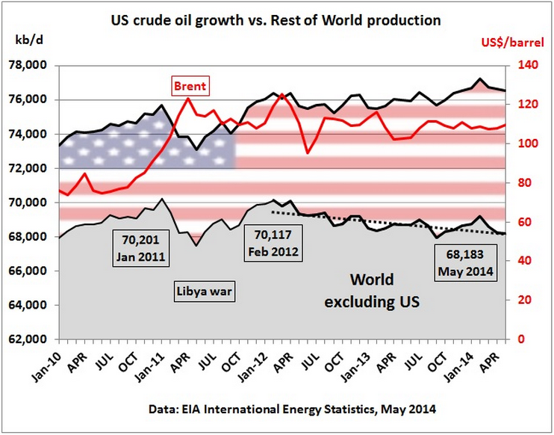
Figure 2

Slide 3
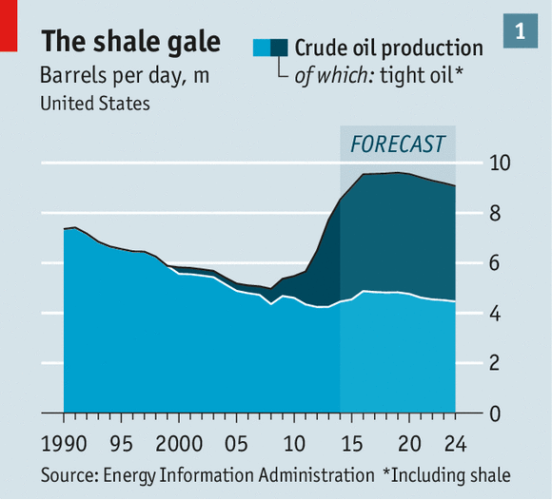
Figure 1
Tight oil (also known as shale oil or light tight oil, abbreviated LTO) is petroleum that consists of light crude oil contained in petroleum-bearing formations of low permeability, often shale or tight sandstone.
en.wikipedia.org/wiki/Tight_oil

Slide 4
Preparation
Understand exactly what the graph shows
Take notes on major trends (descriptive)
Relate reasons/causes to specific moments
Interpret trends in different ways
Recalculate values as relative shares (percentages)
Identify correlations between events/information
Step back for a more distant view that identifies other trends
Plan text structure.

Slide 5
Figure 2 shows the evolution in the price of Brent and world production of crude oil, broken into US production and that of the rest of the world for the period 2010-2014. Overall, global production shows a rising trend. There was a temporary dip in the first two quarters of 2011, which corresponds to a period of war in Libya, who is an oil producer. Since 2012 US crude oil output has risen, due to an increase in the production of tight oil. During the same period oil production outside the US has declined.
Until 2012 the trends in global production were dominated by oil producers excluding the US, but since then the relative share of US oil production in world production has increased. Their share in world production has grown from just under 8% in 2011 to over 10% in 2014. This increased share has given the US more sway in the oil business such that the rest of the world production no longer dictates the global production trends.
The price of Brent stood at under US$80/barrel in January 2010. There was a sharp rise between October 2010 and April 2011, followed by fluctuations fill July 2012. The rise in the price of Brent partly coincided with a drop in world oil production and the war in Libya, and as world production recovered in the second half of 2011, the price of Brent fell. Over the whole period there are two spikes where the price reached over US$120/barrel. In general, since early 2011 the price has remained high, above US$100/barrel except for a temporary drop to just over US$90 in July 2012.

Slide 6
Figure 2 shows the evolution in the price of Brent and world production of crude oil, broken into US production and that of the rest of the world for the period 2010-2014. Overall, global production shows a rising trend. There was a temporary dip in the first two quarters of 2011, which corresponds to a period of war in Libya, who is an oil producer. Since 2012 US crude oil output has risen, due to an increase in the production of tight oil. During the same period oil production outside the US has declined.
Until 2012 the trends in global production were dominated by oil producers excluding the US, but since then the relative share of US oil production in world production has increased. Their share in world production has grown from just under 8% in 2011 to over 10% in 2014. This increased share has given the US more sway in the oil business such that the rest of the world production no longer dictates the global production trends.
The price of Brent stood at under US$80/barrel in January 2010. There was a sharp rise between October 2010 and April 2011, followed by fluctuations fill July 2012. The rise in the price of Brent partly coincided with a drop in world oil production and the war in Libya, and as world production recovered in the second half of 2011, the price of Brent fell. Over the whole period there are two spikes where the price reached over US$120/barrel. In general, since early 2011 the price has remained high, above US$100/barrel except for a temporary drop to just over US$90 in July 2012.

Slide 7
Figure 2 shows the evolution in the price of Brent and world production of crude oil, broken into US production and that of the rest of the world for the period 2010-2014. Overall, global production shows a rising trend. There was a temporary dip in the first two quarters of 2011, which corresponds to a period of war in Libya, who is an oil producer. Since 2012 US crude oil output has risen, due to an increase in the production of tight oil. During the same period oil production outside the US has declined.
Until 2012 the trends in global production were dominated by oil producers excluding the US, but since then the relative share of US oil production in world production has increased. Their share in world production has grown from just under 8% in 2011 to over 10% in 2014. This increased share has given the US more sway in the oil business such that the rest of the world production no longer dictates the global production trends.
The price of Brent stood at under US$80/barrel in January 2010. There was a sharp rise between October 2010 and April 2011, followed by fluctuations fill July 2012. The rise in the price of Brent partly coincided with a drop in world oil production and the war in Libya, and as world production recovered in the second half of 2011, the price of Brent fell. Over the whole period there are two spikes where the price reached over US$120/barrel. In general, since early 2011 the price has remained high, above US$100/barrel except for a temporary drop to just over US$90 in July 2012.

